Slide 1
Linux Containers On Azure
Delivering modern cloud native applications with open source technologies on Azure

Slide 2
Who am I?
Bruno Medina
Bolanos Cacho
SR Software Developer Engineer
Commercial Software Engineering (CSE)
@brusmx

Slide 3
Kubernetes Concepts

Slide 4
Kubernetes Architecture Components
api-server
etcd
master components
controller-manager
scheduler
* Azure Managed
kubelet
kube-proxy
node components
docker
dns

Slide 5
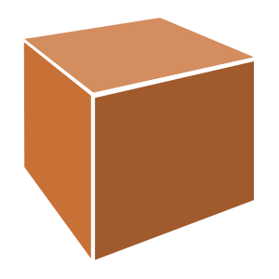



Pod

Slide 6
pod
pod
rating-api
rating-web
port
3000
port
8080
pod
rating-db
port
27017

Slide 7
Deployment
label
app=heroes-web , tier=web
image
azurecr.io/rating-web:v1
pod
heroes-web-1
port
8080
port
pod
heroes-web-2
port
8080
heroes-web

Slide 8
Deployment
label
app=heroes-web, tier=web
image
azurecr.io/rating-web:v1
pod
Service
heroes-web-1
port
8080
Heroes-web
pod
port
selector
app=heroes-web
heroes-web-2
port
8080:8080
port
8080
IP
10.0.2.20
heroes-web

Slide 9

Release automation tools
Azure Container Registry
Azure Kubernetes Service (AKS)
Containers 101
Azure container technology
Release automation tools
Container orchestration
Azure Container Instances (ACI)

Slide 10

Helm
Azure Kubernetes Service (AKS)
An easy way to find, share, and use software built for Kubernetes
Azure Container Instances (ACI)
Azure Container Registry
Manage complexity
Charts can describe complex apps; provide repeatable app installs, and serve as a single point of authority
Easy updates
Take the pain out of updates with in-place upgrades and custom hooks
Simple sharing
Charts are easy to version, share, and host on public or private servers
Rollbacks
Use helm rollout to roll back to an older version of a release with ease
Open Service Broker API (OSBA)
Release Automation Tools

Slide 11

Helm
Azure Kubernetes Service (AKS)
Helm Charts helps you define, install, and upgrade even the most complex Kubernetes application
Azure Container Instances (ACI)
services
ci
db
Azure Container Registry
load balancer
custom
…
Chart.yaml
Open Service Broker API (OSBA)
Release Automation Tools

Slide 12
Demo
Installing curated Apps

Slide 13
Common Toolsets
Jenkins
Visual Studio Team Services
Spinnaker and Netflix OSS
Travis
TeamCity
CircleCI
Additional utilities: code quality scanning, security, collaboration, etc.

Slide 14
Release automation workflow
Azure Kubernetes Service (AKS)
Create
Azure Container Instances (ACI)
Draft create
Have code?
No
New
Draft page
Azure Container Registry
Yes
Builds image/config. to be deployed
Staged?
Yes
Code
Container
Configuration
Draft create or Draft create-pack (if specific artifacts exist)
Deploy image (AKS)
Deploy to staging
No
Open Service Broker API (OSBA)
Push image
Canary deploy to production
CD: No staging
No
Testing good?
Move to dev cluster
Change
Code
Container
Configuration
Actual development, Draft up/connect iteration
The building process: Brigade, Jenkins, VS TS
Build container
Telemetry successful?
Rollback
Yes
No
2 factor authentication
Push to production as canary
Release Automation Tools
Yes
Git push
Pull code
Rollout
Code/artifacts ready

Slide 15


Energy company electrifies pace of innovation and expansion
Ambit Energy provides electricity and natural-gas services in deregulated markets around the world. It uses technology as a competitive differentiator, employing microservices, DevOps, and continuous deployment to speed software development. To stand up infrastructure just as quickly, Ambit uses Microsoft Azure services such as Azure Container Service, together with infrastructure as code and open source technologies, to completely automate infrastructure provisioning. By implementing Azure, Ambit can move dramatically faster to enhance its services and enter new markets. Infrastructure redundancy is flexible and worry-free. And costs are 22 percent lower, which helps Ambit compete in the crowded electricity market. Because Ambit’s cloud journey is gradual, it appreciates the fact that Azure is a great hybrid-cloud enabler, connecting easily to Ambit datacenters.
Products and services
Organization size
Industry
Country
Business need
Microsoft Azure Container Service
1,000 employees
Power and utilities
United States
Optimize operational efficiency

Slide 16

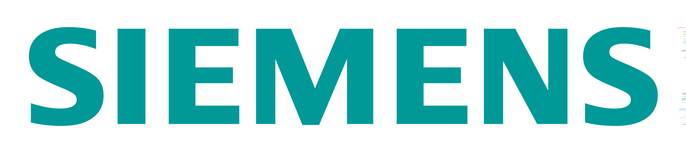
Siemens Health leverages technology to connect medical devices to the cloud through AKS
Digitization and networking between healthcare providers and software development companies are essential to value-based care. Moving from the development of value-added services into becoming more of a platform provider, it became important for Siemens to adopt a microservices approach to application delivery. To that end, Siemens adopted Azure Container Service (AKS) to run their microservices-based apps. AKS puts Siemens in a position not only to deploy business logic in Docker containers—including the orchestration—but also enables them to use an applicant gateway and API management to manage exposure, control, and to meter the access continuously. With their cloud-based development approach, Siemens has driven newfound product development agility. This project is already having a positive impact within the healthcare industry.
Products and services
Organization size
Industry
Country
Business need
Microsoft Azure Container Service
100,000+ employees
Healthcare
Germany
Faster application development

Slide 17

Questions?
Bruno Medina
Bolanos Cacho
SR Software Developer Engineer
Commercial Software Engineering (CSE)
@brusmx

Slide 18
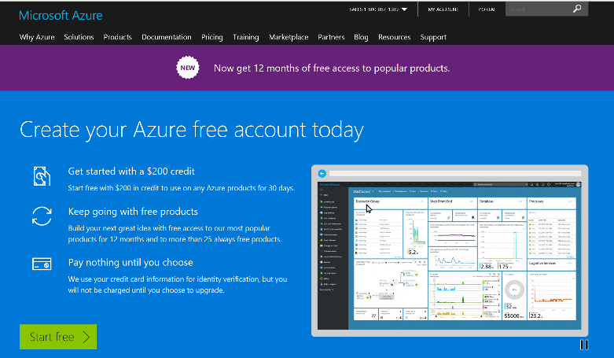
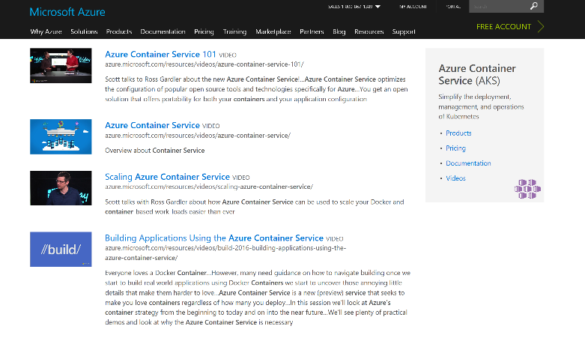
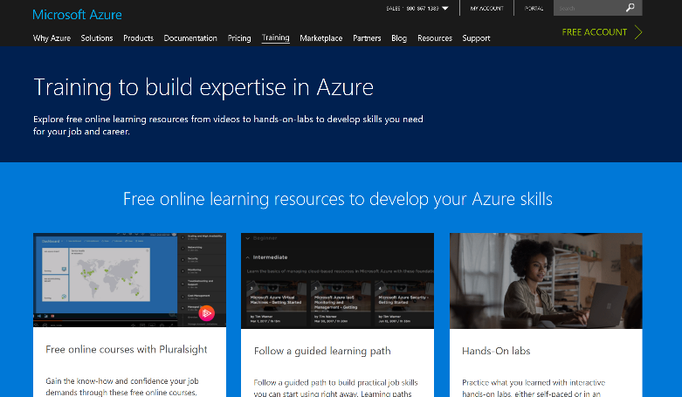
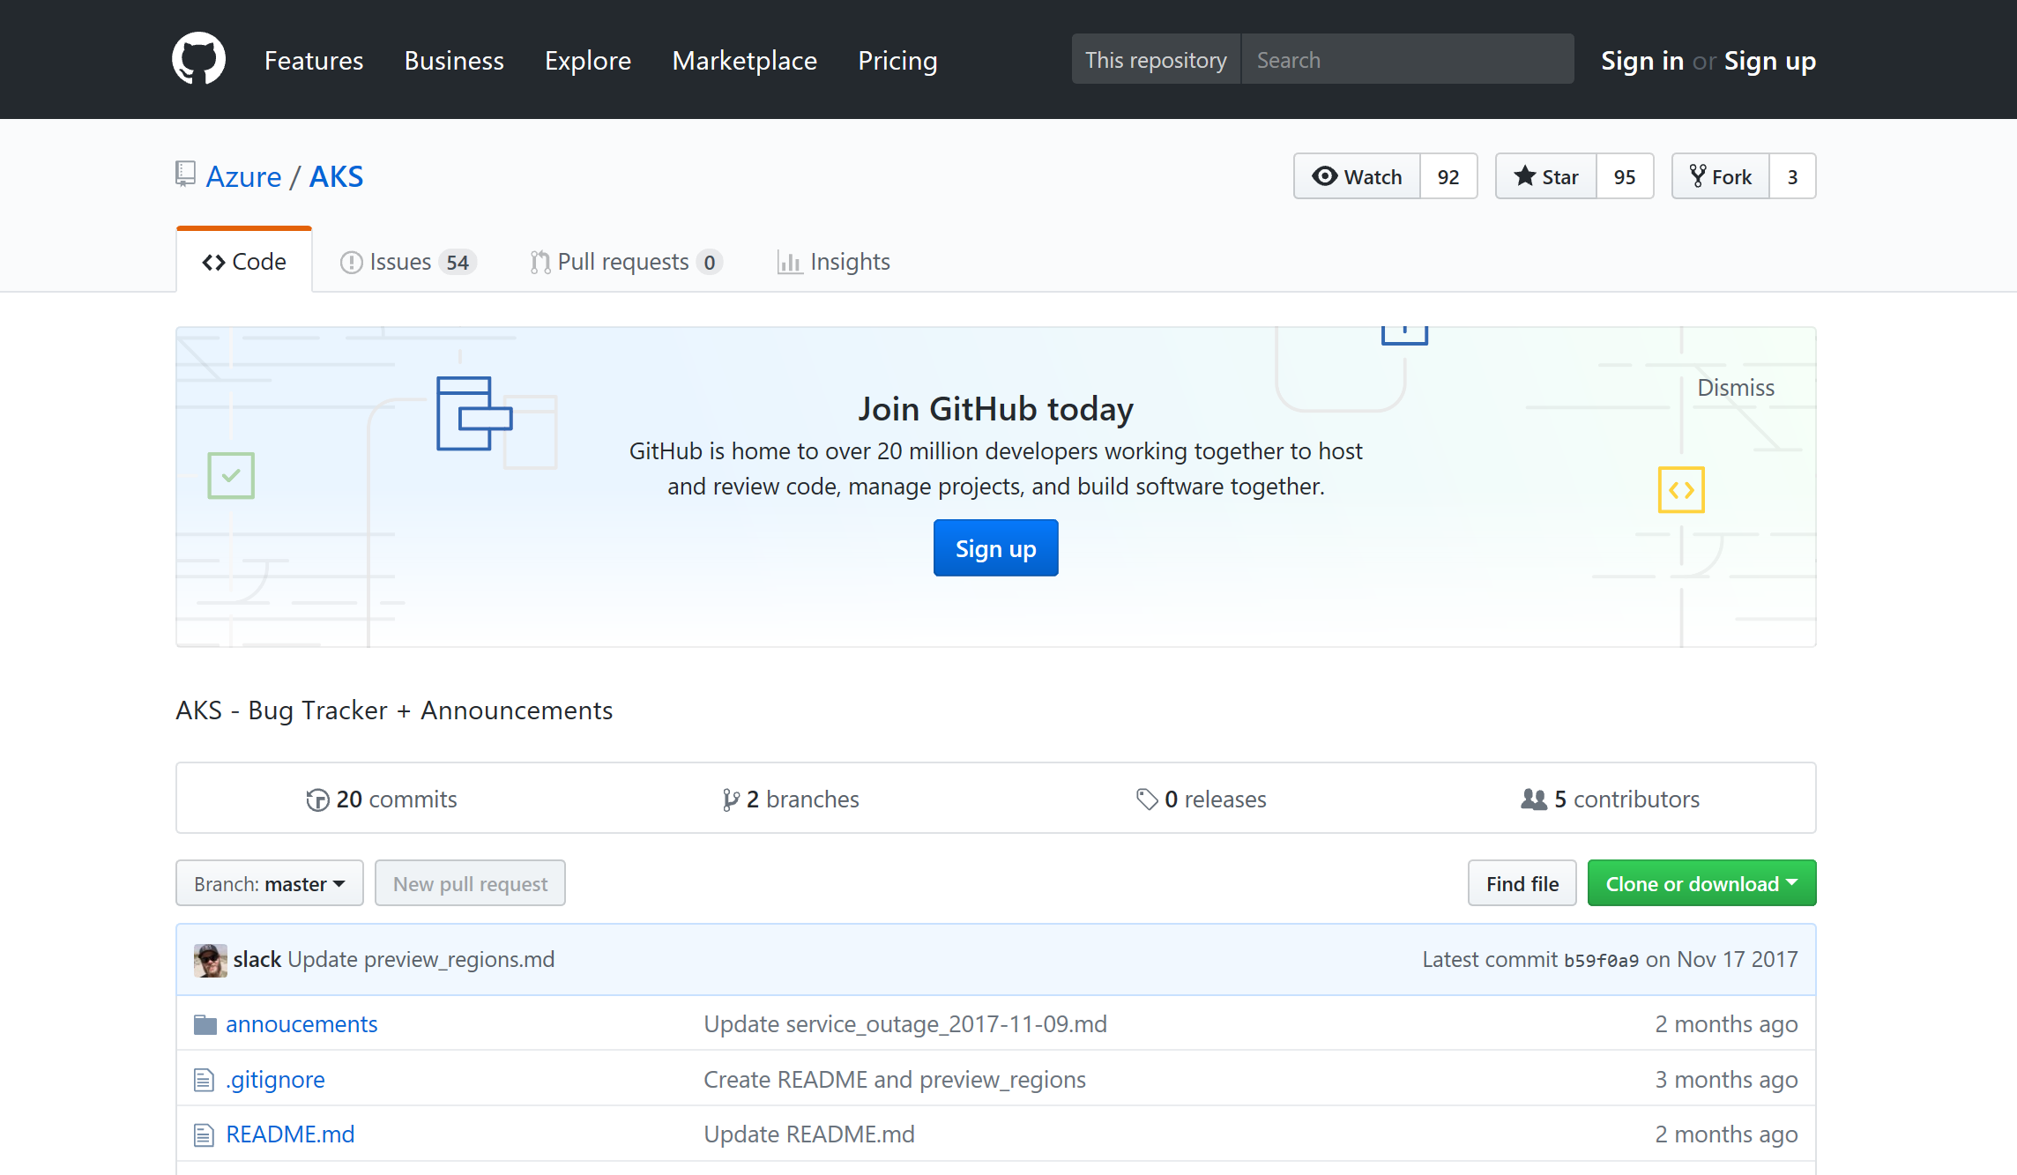
Azure container resources
Azure Kubernetes Service (AKS)
Azure Container Instances (ACI)
Azure Container Registry
OSBA announcement blog
Draft webpage
Helm webpage
Brigade webpage
Kashti announcement blog
Sign up for a free Azure account
Check out the Azure container videos page
Hone your skills with Azure training
Get the code from GitHub

Slide 19
apiVersion: apps/
Kind: deployment
Metadata:
name: rating-web
apiVersion: apps/
Kind: deployment
Metadata:
name: rating-web
apiVersion: apps/
Kind: deployment
Metadata:
name: rating-web
customResorce
micro-web
api-server
port
8000
deployment
service
ingress
rating-web
rating-web
rating-web
port
8080
port
8080
port
8080
pod
pod
rating-web
rating-web
port
8080
port
8080

Slide 20
Managing Storage and State

Slide 21

Managing State For Containers
Azure
Data Service
Local Storage
Remote Storage
Pod
Pod
Pod
CosmosDB

Slide 22
Scaling Applications

Slide 23
Application Scaling Strategies
Infrastructure Level
Increase/decrease the number of VM’s running in the cluster
Azure infrastructure function
via AKS API/CLI (utilizes Azure Availability Sets)
Auto-scaling coming to AKS soon
Application Level
Increase/decrease the number of pods for a given service
Handled by the orchestrator or the application itself
Kubernetes Horizontal Pod Autoscaling
These functions should be coordinated

Slide 24
Scaling Pods
Pod
Pod
Pod
Pod
Pod
Pod

Slide 25
Scaling Host
Pod
Pod
Pod
Pod
Pod
Pod
Pod
Pod

Slide 26
Scaling the ACS Cluster

Slide 27
Monitoring

Slide 28
Current monitoring is static in nature

Slide 29
Need to monitor for dynamic environments
Pod
Pod
Pod
Pod
Pod
Pod
Pod
Pod
Pod
Pod
Pod
Pod
Pod
Pod
Pod
Pod

Slide 30
Application Health and Readiness
Kubelets on workers use liveness and readiness probes to know when to restart a container or start directing traffic
Liveness check: when to restart
Readiness check: when to forward Service traffic to a pod
Notes:
Look at liveness
Look at readiness

Slide 31
Monitoring: What indicators matter in Kubernetes
Cluster health: total number of nodes, pods, etc
Node health: available compute resources, health
Application health
Tooling Examples
Datadog
Prometheus
InfluxData
Cloud-specific: OMS (Azure), CloudWatch (AWS)
Notes:
https://docs.datadoghq.com/integrations/kubernetes/

Slide 32
Logging
Pod logs: applications must log to standard out!
Cluster-wide event logs
Logging forwarder solutions
fluentd
logstash
Log indexers
OMS Log Analytics
Splunk
ELK stack

Slide 33
Microservices

Slide 34
microservices ≠ containers
microservices is an architectural design approach
containers are an implementation detail that often helps

Slide 35
Microservices Benefits
Independent deployments
Enables continuous delivery
No downtime upgrades
Improved scale and resource utilization per service
Fault isolation
Security isolation
Services can be distributed across multiple servers or environments
Multiple languages / diversity
Smaller, focused teams
Code can be organized around business capabilities
Autonomous developer teams

Slide 36
Microservices – The Hard Part
Deployment is complex
Testing is difficult
Debugging is difficult
Monitoring/Logging is difficult
New service versions must support old/new API contracts
Distributed databases make transactions hard
Cluster and orchestration tools overhead
Distributed services adds more network communication
Increased network hops
Requires failure/recovery code
Need service discovery solution
Advanced DevOps capability: short-term pain for long-term gain

Slide 37
12-Factor Apps
http://12factor.net
Notes:
Explain the benefits of 12 factor apps without walking through all of them.
Recommended guidelines for good microservices apps

Slide 38
12-Factor Apps (1-5)
Single root repo; don’t share code with another app
Deploy dependent libs with app
No config in code; read from environment vars
Handle unresponsive app dependencies robustly
Strictly separate build, release, & run steps
Build: Builds a version of the code repo & gathers dependencies
Release: Combines build with config ReleaseId (immutable)
Run: Runs app in execution environment
Notes:
Single root repo; don’t share code with another app
Deploy dependent libs with app
No config in code; read from environment vars
Handle unresponsive app dependencies robustly
Strictly separate build, release, & run steps
Build: Builds a version of the code repo & gathers dependencies
Release: Combines build with config → ReleaseId (immutable)
Run: Runs app in execution environment

Slide 39
12-Factor Apps (6-12)
App executes as 1+ stateless process & shares nothing
App listens on ports; avoid using (web) host
Use processes for isolation; multiple for concurrency
Processes can crash/be killed quickly & start fast
Keep dev, staging, & prod environments similar
Log to stdout (dev=console; prod=file & archived)
Deploy & run admin tasks (scripts) as processes
Notes:
App executes as 1+ stateless process & shares nothing
App listens on ports; avoid using (web) host
Use processes for isolation; multiple for concurrency
Processes can crash/be killed quickly & start fast
Keep dev, staging, & prod environments similar
Log to stdout (dev=console; prod=file & archived)
Deploy & run admin tasks (scripts) as processes

Slide 40
ConfigMaps and Secrets
Flexible configuration model for Kubernetes
Both Secrets and ConfigMaps can be used as ENV vars or files
Secrets
Use Secrets for things which are actually secret like API keys, credentials, etc
Secret values are base64 encoded and automatically decoded for pods
ConfigMaps
ConfigMaps for configuration that doesn’t have sensitive information. However, there are pros/cons with each
ConfigMaps designed to more conveniently support working with strings
Notes:
Decouple configuration artifacts from image content to keep containerized applications portable

Slide 41
Namespaces
Allow for multiple virtual clusters backed by the same physical cluster
Logical separation
Namespace used in FQDN of Kubernetes services
Eg - <service-name>.<namespace-name>.svc.cluster.local
Every Kubernetes resource type is scoped to a namespace (except for nodes, persistentVolumes, etc.)
Intended for environments with many users, teams, projects
Notes:
Can use –all-namespaces option with kubctl if resources can’t be found
Compatible with RBAC; can lock down namespaces
Useful for clusters that have multiple teams deploying to

Slide 42
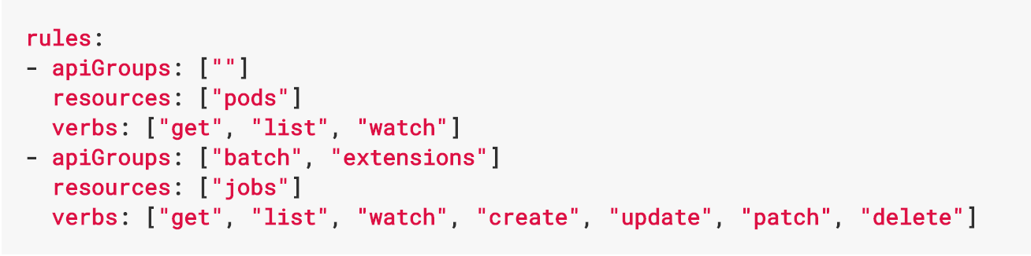
Role Based Access Control
Allows for dynamic policies against k8s API for authZ
In version 1.6, this is a beta feature
Can create both ”Roles” and “ClusterRoles”
Can configure api-server and kubectl to use Azure AD for access
To grant permissions:
Use ”RoleBindings” for within namespaces
Use “ClusterRoleBindings” for cluster-wide access
Can contain users, groups, service accounts
Control access to specific resources or API verbs

Slide 43
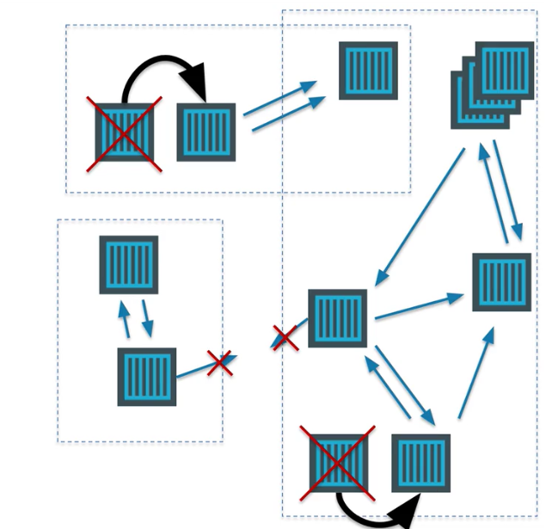
Networking in the Container World

Slide 44
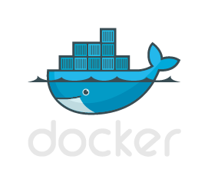

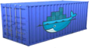
Multi-Host Networking
Agent1
Agent2
eth0 : 10.0.0.6
eth0 : 10.0.0.8
docker0 : 172.17.0.1
docker0 : 172.17.0.1
eth0 : 172.17.0.3
eth0 : 172.17.0.3
eth0 : 172.17.0.4
eth0 : 172.17.0.4
vethxxx
vethxxx
vethxxx
vethxxx

Slide 45




Multi-Host Networking
Agent1
key/value
store
Agent2
eth0 : 10.0.0.6
eth0 : 10.0.0.8
docker0 : 172.17.0.1
docker0 : 172.17.0.1
192.168.0.0/24
eth0 : 192.168.0.1
eth0 : 192.168.0.3
eth0 : 192.168.0.2
eth0 : 192.168.0.4
vethxxx
vethxxx
vethxxx
vethxxx

Slide 46
What is service discovery?
Problem: How service can find and communicate with another one running into the same cluster?
Service Registry/Naming Service
Service Announcement
Lookup/Discovery
Load Balancing
?!?

Slide 47
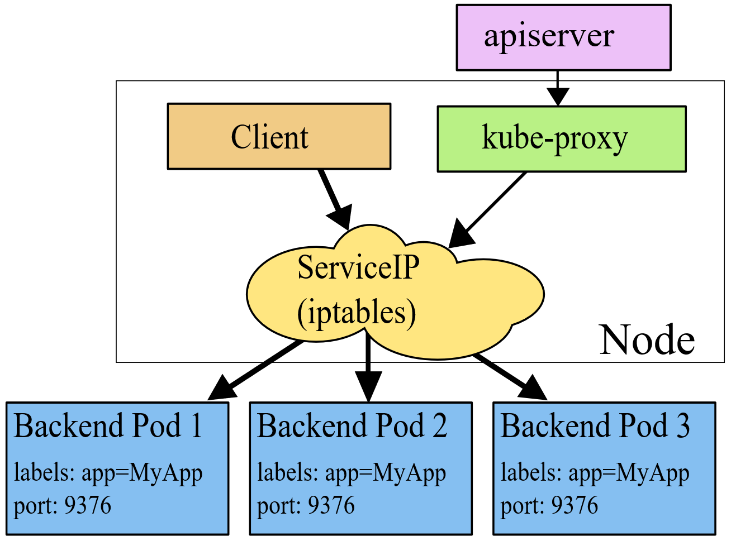
Networking in Kubernetes
Kubernetes Networking model introduces 3 methods of communications:
Pod-to-Pod communication directly by IP address. Kubernetes has a Pod-IP wide metric simplifying communication.
Pod-to-Service Communication – Client traffic is directed to service virtual IP by iptables rules that are modified by the kub-proxy process (running on all hosts) and directed to the correct Pod.
External-to-Internal Communication – external access is captured by an external load balancer which targets nodes in a cluster. The Pod-to-Service flow stays the same.
Notes:
When the backend Service is created, the Kubernetes master assigns a virtual IP address, for example 10.0.0.1. Assuming the Service port is 1234, the Service is observed by all of the kube-proxy instances in the cluster. When a proxy sees a new Service, it installs a series of iptables rules which redirect from the VIP to per-Service rules. The per-Service rules link to per-Endpoint rules which redirect (Destination NAT) to the backends.
When a client connects to the VIP the iptables rule kicks in. A backend is chosen (either based on session affinity or randomly) and packets are redirected to the backend. Unlike the userspace proxy, packets are never copied to userspace, the kube-proxy does not have to be running for the VIP to work, and the client IP is not altered.
This same basic flow executes when traffic comes in through a node-port or through a load-balancer, though in those cases the client IP does get altered.

Slide 48
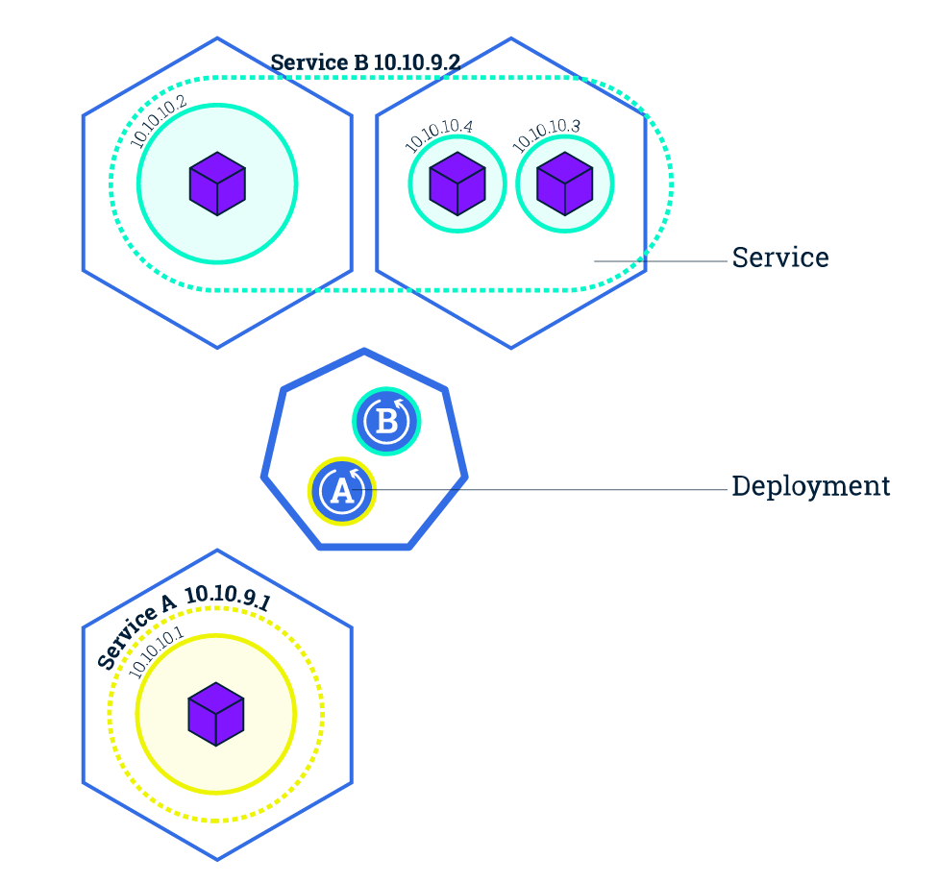
Service Discovery with Kubernetes
Nodes, Deployments, Pods, Services
Services
Expose the services
Works with platform Load Balancers to get public IPs
Internal load balancing between pods
kube-dns (preferred)
Name service enabled in Kubernetes (Default in ACS)
Environment Variables
Every Service is assigned environment variables with information of the service
REDIS_MASTER_SERVICE_HOST=10.0.0.11 REDIS_MASTER_SERVICE_PORT=6379 REDIS_MASTER_PORT=tcp://10.0.0.11:6379 REDIS_MASTER_PORT_6379_TCP=tcp://10.0.0.11:6379 REDIS_MASTER_PORT_6379_TCP_PROTO=tcp REDIS_MASTER_PORT_6379_TCP_PORT=6379 REDIS_MASTER_PORT_6379_TCP_ADDR=10.0.0.11
Source: https://kubernetes.io/docs/tutorials/kubernetes-basics/expose-intro/
Notes:
NOTE ON ENVIRONMENT VARIABLES: This does imply an ordering requirement - any Service that a Pod wants to access must be created before the Pod itself, or else the environment variables will not be populated. DNS does not have this restriction.

Slide 49
Ingresses
Typically, services and pods have IPs only routable by the cluster network
All traffic that ends up at an edge router is either dropped or forwarded elsewhere
Ingress is a collection of rules that allow inbound connections to reach the cluster services
An Ingress controller is responsible for fulfilling the Ingress, usually with a loadbalancer, though it may also configure your edge router or additional frontends to help handle the traffic in an HA manner
Notes:
I
Pods won’t survive scheduling failures, node failures, or other evictions, such as due to lack of resources, or in the case of node maintenance.

Slide 50
Container Network Interface (CNI)
CNI (a CNCF project) is a spec for plugins to configure Linux container network interfaces
Wide range of support
Kubernetes, OpenShift, Cloud Foundry, Mesos, rkt, etc.
Examples
Calico, Weave, Contiv, etc.
Azure CNI plug-in integrates Azure VNET into kubernetes clusters
Use acs-engine
Notes:
CNCF = Cloud Native Computing Foundation
https://github.com/Azure/azure-container-networking/blob/master/docs/acs.md

Slide 51
Daemonsets
Ensures that all (or some) nodes run a copy of a pod
Doesn't care if a node is marked as unschedulable
Can make pods even if the scheduler is not running

Slide 52
StatefulSets
Used for workloads that require consistent, persistent hostnames e.g. etcd-01, etcd-02
One PersistentVolume storage per pod
StatefulSet example - zookeeper
StatefulSet example - cockroachdb
Notes:
Manages the deployment and scaling of a set of Pods, and provides guarantees about the ordering and uniqueness of these Pods.
StatefulSets are valuable for applications that require one or more of the following.
Stable, unique network identifiers.
Stable, persistent storage.
Ordered, graceful deployment and scaling.
Ordered, graceful deletion and termination.
Ordered, automated rolling updates.

Slide 53
Jobs
Creates one or more pods and ensures that a specified number of them successfully terminate
3 types of jobs
Non-parallel Jobs - e.g. single pod done when exit is successful
Parallel Jobs with a fixed completion count - e.g. one successful pod for each value in the range 1 to .spec.completions
Parallel Jobs with a work queue that coordinate with each other and terminate when one pod exits successfully

Slide 54

Questions?
Bruno Medina
Bolanos Cacho
SR Software Developer Engineer
Commercial Software Engineering (CSE)
@brusmx

Slide 55
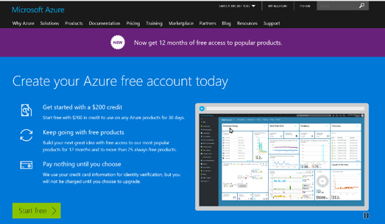


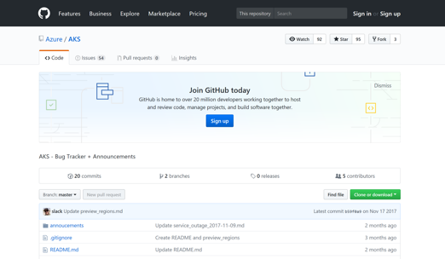
Azure container resources
Azure Kubernetes Service (AKS)
Azure Container Instances (ACI)
Azure Container Registry
OSBA announcement blog
Draft webpage
Helm webpage
Brigade webpage
Kashti announcement blog
Sign up for a free Azure account
Check out the Azure container videos page
Hone your skills with Azure training
Get the code from GitHub

